Slide 1
Omni-Channel Engagement helping companies
Drive loyalty, Grow Revenue: Why & How
Hanoi, 26 July 2017

Slide 2
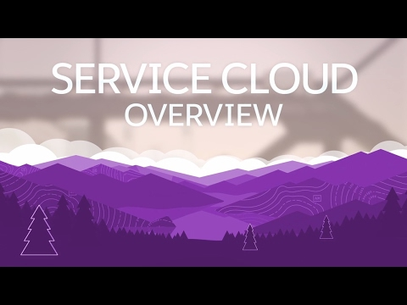
Service Cloud Lightning Overview

Slide 3
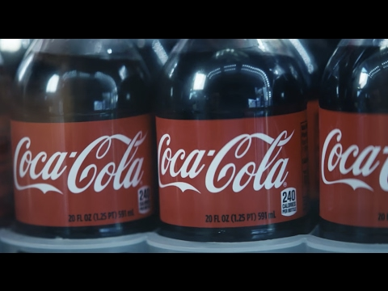
Coca-Cola's Success Story

Slide 4
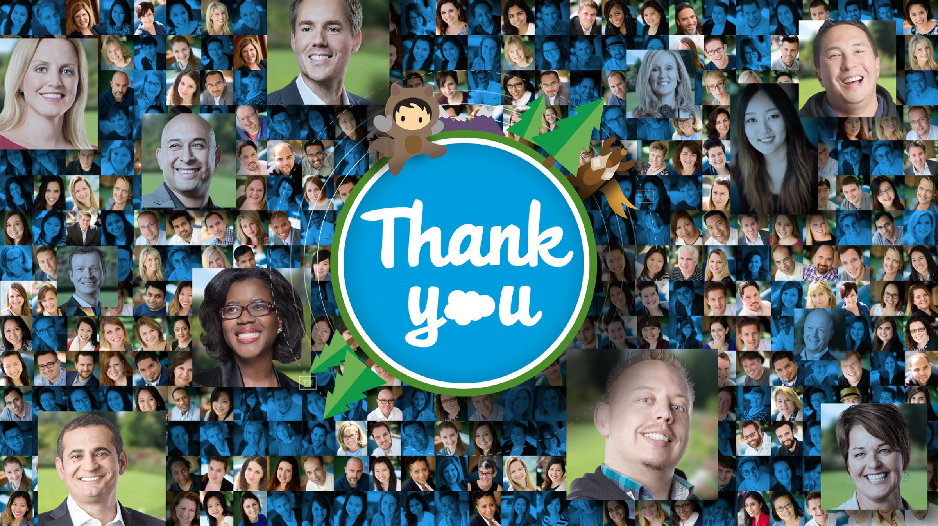
Notes:
Talk Track Thank you for meeting with me today and thank you for being a great Salesforce customer for [XX] years. We appreciate your business. Key Message
Thank the customer for spending time with us today.
We owe all of our success to our customers. Make sure they understand that nothing is more important to us than their success.
The customer is the hero in this story, not us.

Slide 5

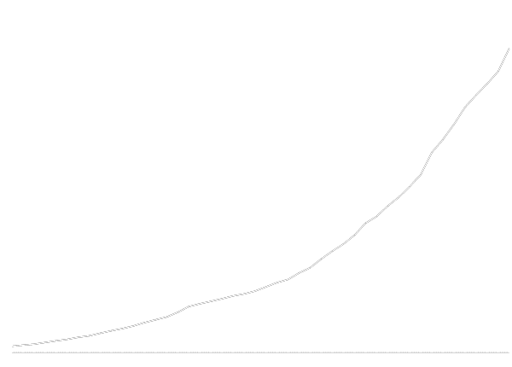




Together, We’re Building a Path Forward
$2.04B
FY17Q2 revenue
“Innovator of the Decade”
The world’s most innovative companies
24K
employees
September 2016
2011 • 2012 • 2013
2014 • 2015 • 2016
$389B
in GDP impact by 2020*
2009 • 2010 • 2011
2012 • 2013 • 2014
2015 • 2016
2M
jobs created by 2020
IDC White Paper, sponsored by Salesforce, "The Salesforce Economy," August 2016
Notes:
Talk Track We're thrilled with the success we've achieved together with our customers, partners, and success community. We're proud to be called “Innovator of the Decade” and humbled to be named one Fortune’s “Best Place to Work” eight years in a row. But what we're most proud of is how our customers are innovating – they're disrupting markets, transforming industries, developing new business models and much, much more. Together, we've built an amazing company and community that will contribute almost 400B in GDP impact and create 2M jobs by 2020. Key Message
Our success is a reflection of our customers' success. We couldn't have achieved any of this without them.
Customers don't just buy Salesforce. They join the Salesforce Ohana.
Customers take our platform and make amazing things happen everyday – This is an opportunity to thank them again.
Pro Tips
Be humble!

Slide 6
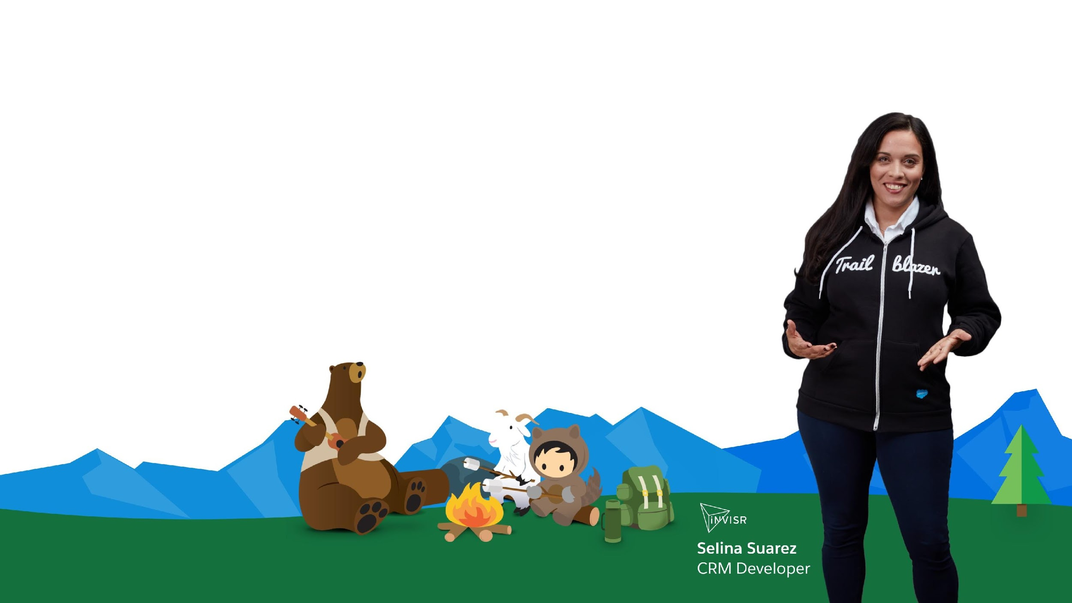



Empowering Everyone to be a Customer Trailblazer
Three models that empower Trailblazers
Business Model
Focused on Customer Success
Subscription Model
Trusted customer advisors
Success community
MVPs
Technology Model
Most trusted
enterprise cloud
Multitenant cloud
Fast time to value
Scalable metadata platform
Rapid customization
Learning Model
Fun and easy way to learn to be your best
trailhead.salesforce.com
1M+ badges completed
144 badges available
25%
revenue growth
25%
reduction in IT costs
Source: Salesforce Customer Relationship Survey conducted 2014-2016 among 10,500+ customers randomly selected. Response sizes per question vary. Percentages are an average.
Notes:
Talk Track We define individuals and companies who leverage Salesforce to drive innovation, solve problems, transform their company and grow their career as Customer Trailblazers. We're empowering everyone to be a Customer Trailblazer, and we do that with three different models: First is our Business Model which is focused on customer success so much that we are based off a subscription-model. Your success is our success. And, to help deliver that success, we have a global customer success team and an enthusiastic community of MVPs and user groups. Next, we have our Technology Model which at its core is the most trusted enterprise cloud. You can easily customize Salesforce to your unique business needs and build apps with click, not code, so you can deliver faster time to value. Finally, there's our Learning Model: Trailhead. Trailhead is our guided learning path that makes learning Salesforce easy and fun. Anyone and everyone can learn about Salesforce and transform their business. Key Message
With our Business Model, our success is directly dependent on the success of our customers.
Our Technology Model democratizes software. Use the apartment building analogy to explain the advantage of our multi-tenant cloud.
With Trailhead, anyone can learn Salesforce and become a Customer Trailblazer.

Slide 7
Agenda
08:00-09h00: Registration - Morning coffee and Finger food - Gimasys team
09h00-09h10: Welcome Note & Agenda Overview - Ms.Adelyn & Mr.Dinh Kien Quoc
09h10-10h00: Keynote - The Asia Customer Experience Imperative – Omni Channel engagement helping companies grow Revenue: Why & How * With a quick 10 minutes Demo -Mr. Punnet Sharma
10:00 - 10:15: Why Go with Salesforce and What is The Next Journey - Techcombank Securities
10h15-10h45: Turning CRM Ideas into Reality for your Business - How Gimasys can Help - Practical Deployment Service & Integration Demo - Mr.Dinh Kien Quoc
10:45 - 10:55: Tea-break
10:55 - 11:30: Customer Success Stories - Be8 - Mr.Sean
11:30 - 11:45: Q&A - All Presenters
11:45: Close + Wrap Up - Mr. Dinh Kien Quoc & Ms.Adelyn

Slide 8
Q&A

Slide 9
Notes:
Thank you!

